Slide 1

STOCK MARKET ANALYSIS AND FORECASTING
SUPERVISOR
Dr.Phani Krishna sir
DEPARTMENT OF EEE
Team Members
K.G.S.S Karthik - 521151
A.Mohith - 521105
B.Tharun - 521121

Slide 2

TABLE OF CONTENTS :
Aim
Introduction
Flow of Project
Objectives
Literature Survey
Dataset samples
Dataset analysis
Model selection
Structure of GRU
Codes and Results
Future work

Slide 3
Aim
Analysis and Predicting the stock values of companies using RNN

Slide 4
FLOW OF PROJECT:
Collection of data
Cleaning of data
Analysing the data
Training the model
Choosing appropriate algorithm
Forecasting

Slide 5
Introduction:
In this project, we're diving into the world of stock market analysis using a specialized tool called Recurrent Neural Networks (RNN) with Gated Recurrent Units (GRU). In simple terms, they're help us to pred of the stock market's past behaviors and predict potential future trends.
Here's the breakdown: GRU is like the brain of our computer model. We're training it on a heap of historical stock data, essentially teaching it the ropes of market dynamics. The cool part is that it's designed to remember important details, helping it pick up on patterns over time.
So, the mechanics go like this: We feed the GRU tons of data about past stock market movements. It learns from this data, creating a sort of mental map of what typically happens. Then, when faced with a similar scenario in the future, it uses its learned knowledge to make predictions.
It's not foolproof, but it's a sophisticated approach. Join us as we unravel the inner workings of our RNN-GRU project, showcasing how we're applying this technology to decode the stock market's complexities and provide valuable insights for informed decision-making

Slide 6
Objectives:
Data Collection
Data Cleaning
Data Analysis
Our primary objective in this phase is to gather comprehensive and reliable stock market data from diverse sources, enriching our dataset for robust analysis and forecasting so we avoid collecting data from popular sources such as Kaggle and hugging face . Key elements of our data collection strategy include: collecting data from stock exchange websites such as Alpha vintage through API calls
In the data cleaning phase, our primary aim is to refine the acquired dataset systematically. We focus on addressing discrepancies, handling missing values, and standardizing formats to ensure a polished and reliable foundation. By eliminating noise and inconsistencies, we optimize the dataset for our RNN-GRU model, enhancing its reliability and contributing to the overall robustness of our analytical framework.
The dataset comprises X rows and Y columns with various features. Numerical variables such as age and income exhibit mean, median, mode, minimum, and maximum values.Visualizations,including histograms and scatter plots, reveal trends and patterns. Correlation matrices uncover relationships between variables, highlighting significant correlations and insights for further analysis.
Ref: Alpha Vantage documentation

Slide 7
Objectives:
Model Training
Forecasting Accuracy
Comparative Analysis
In the model training phase, our primary goal is to empower the RNN-GRU model for effective stock market trend comprehension and forecasting. Through comprehensive training sessions, we utilize GRU's memory-enhanced features to capture temporal dependencies within market dynamics. Our focus is on cultivating a model that adeptly recognizes historical patterns and dynamically adapts to evolving market conditions. This trained model becomes a robust tool for accurate stock market forecasting, offering valuable insights for well-informed investment decisions in the dynamic financial landscape.
In the forecasting accuracy phase, our primary goal is to ensure precise predictions from our RNN-GRU model regarding stock market trends. By applying the trained model to anticipate future market movements, we provide stakeholders with valuable insights for well-informed investment decisions. We focus on refining the model's ability to capture complex patterns, enhancing its accuracy in navigating the dynamic landscape of the stock market. This objective aims to deliver a reliable tool for investors, contributing to strategic decision-making in the ever-changing realm of the financial market.
In the comparative analysis phase, we aim to evaluate our RNN-GRU model against traditional stock market prediction methods. This involves highlighting the unique strengths of our deep learning approach and understanding how it stands out in providing a more accurate perspective on stock market dynamics. The goal is to offer insights that guide stakeholders towards informed decision-making in the dynamic financial landscape.
Ref: Alpha Vantage documentation

Slide 8
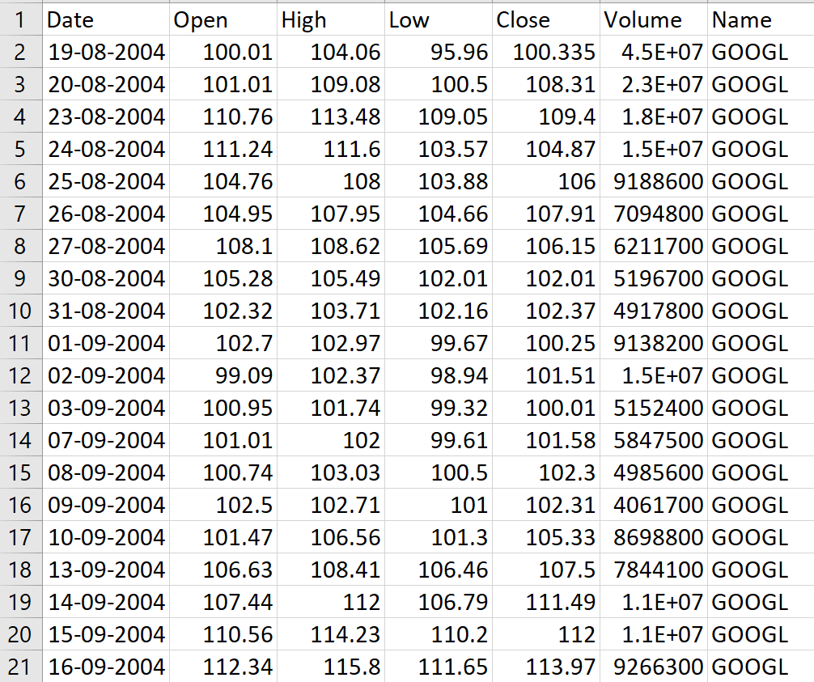
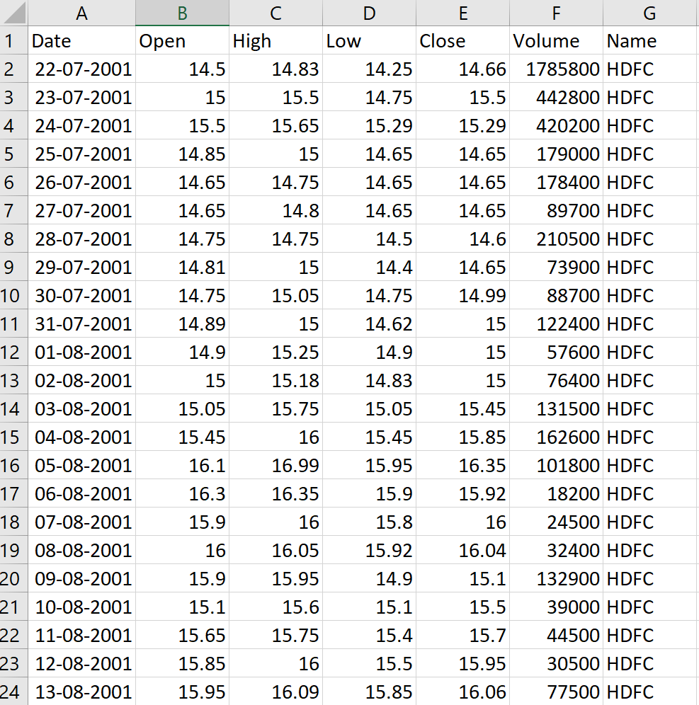
Data Samples:

Slide 9
Literature Survey
IEEE Papers | Brief Overview
[1]Achmad Fauzan, "Predicting Stock Market Movements Using Long Short-Term Memory (LSTM)” | This research paper delves into leveraging artificial intelligence (AI) techniques, specifically Gated Recurrent Units (GRU), to forecast stock market movements and construct optimal investment portfolios. The study employs GRU networks to anticipate stock performance, aiming to amalgamate AI capabilities with human expertise for crafting an intelligent trading framework. The findings underscore the significance of selecting suitable AI methodologies for precise predictions and efficient portfolio management. The outcomes of this investigation reveal that GRU models exhibit a high degree of accuracy in predicting stock prices, with an average prediction accuracy of approximately 97.2938%. The mean error rate observed with GRU-based predictions stands at 2.3223%, highlighting the efficacy of GRU networks in stock market forecasting.
[2]Nilima Zade, "Technical Analysis of Stock Market Trends using LSTM for Price Prognosis" | This study proposes the application of Gated Recurrent Units (GRU) neural networks for in-depth analysis of stock market patterns and trends to forecast future stock prices. A comparative analysis is conducted with three other machine learning techniques to demonstrate the superiority of GRU implementations. The GRU model is trained on historical stock market data, encompassing prices and trading volumes, to grasp intricate patterns and correlations with stock price movements. The model's predictive accuracy in forecasting future stock prices is assessed, revealing that GRU offers superior performance compared to conventional time-series forecasting methods. GRU's capability to capture long-term dependencies and intricate relationships within the dataset renders it a valuable tool for traders and investors aiming to make informed decisions based on technical analysis of stock market trends. The study showcases the potential of GRU in stock market prediction, enhancing investment decision-making processes with precise price forecasts.

Slide 10
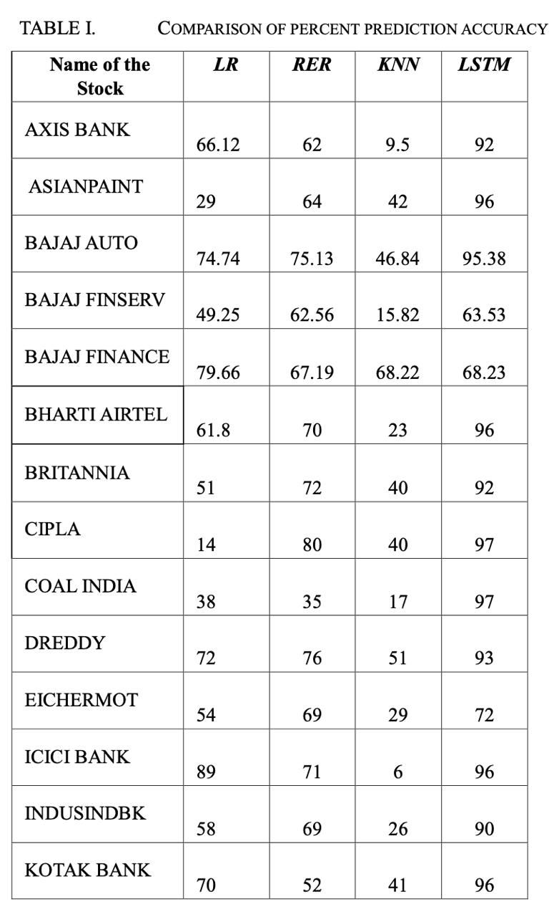
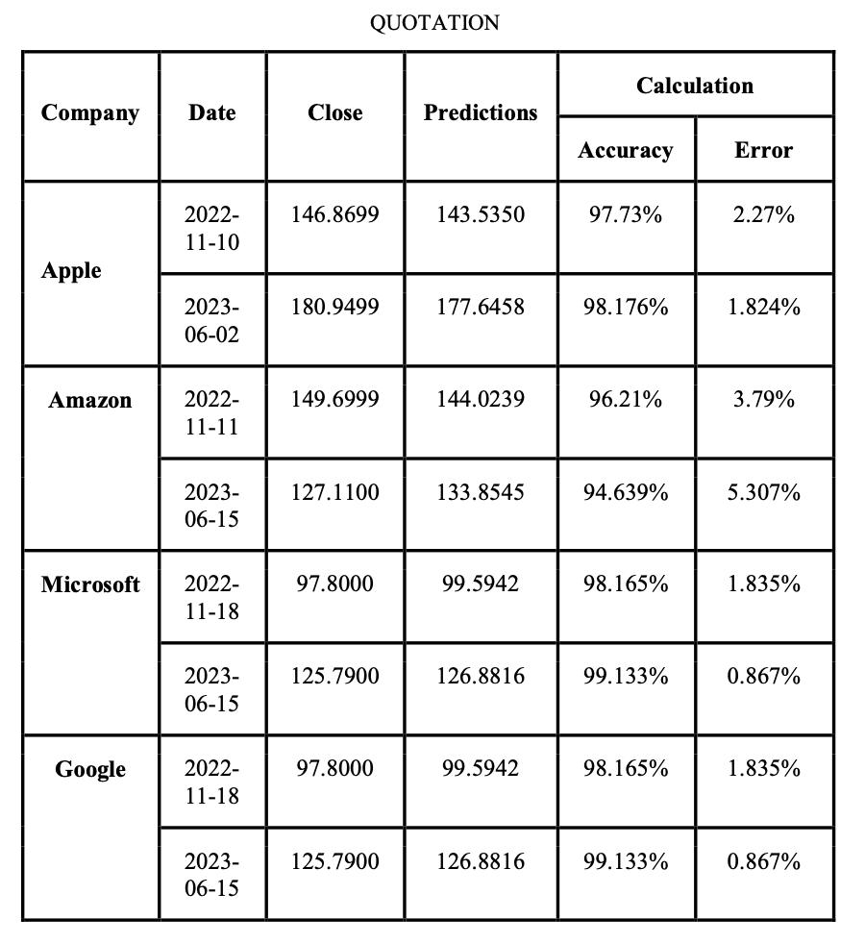
Choosing Model
Accuracy values for different models
Accuracy values for GRU model

Slide 11
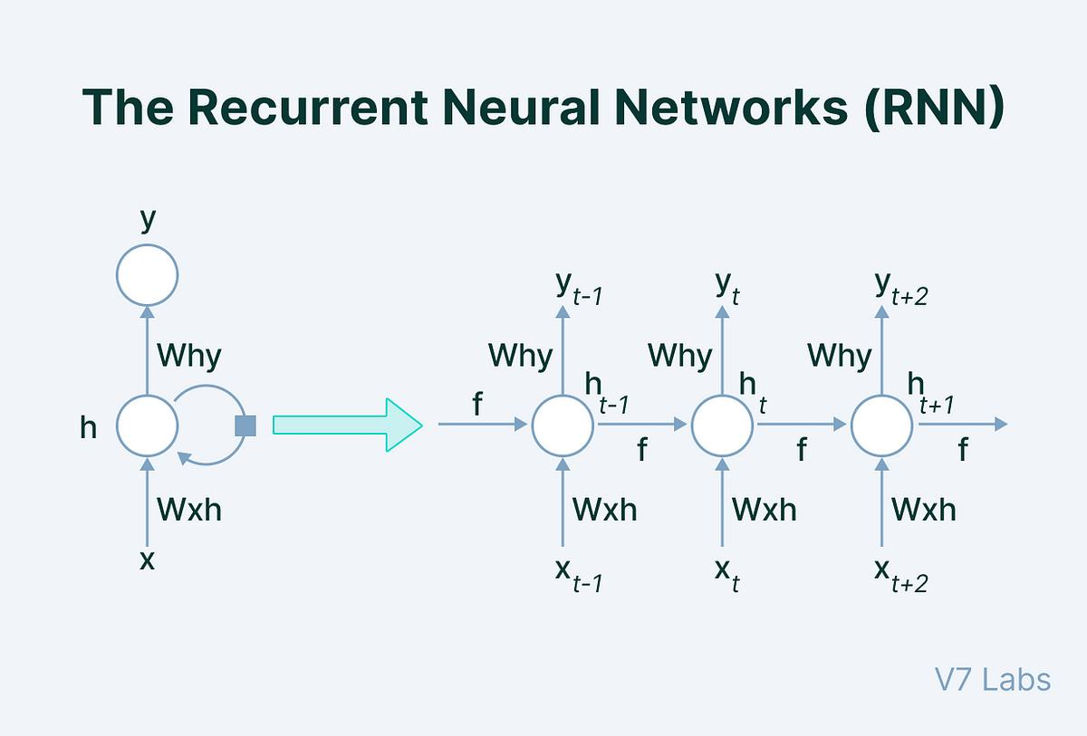

Slide 12
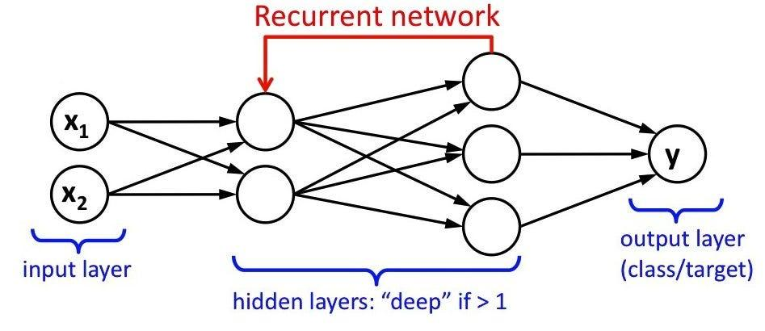

Slide 13
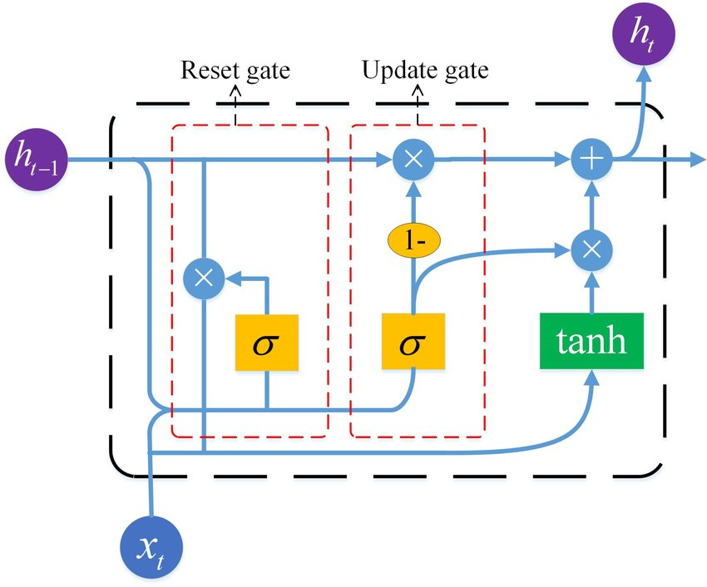
Structure of GRU
.

Slide 14
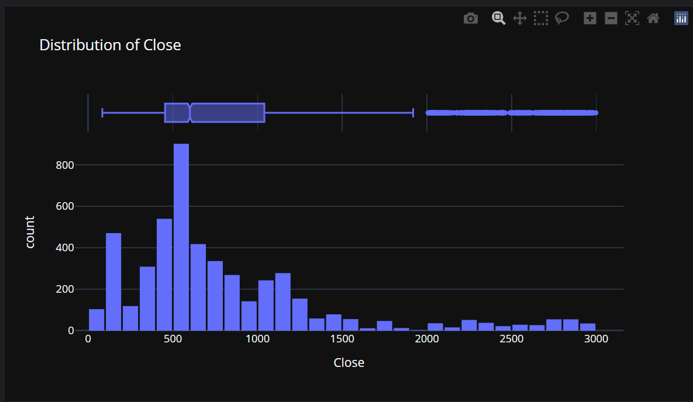
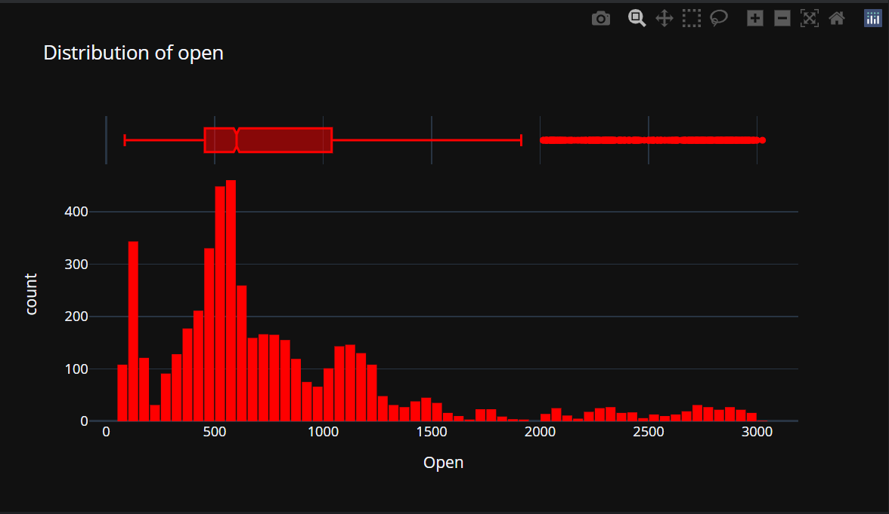
Open vs close distribution for google

Slide 15
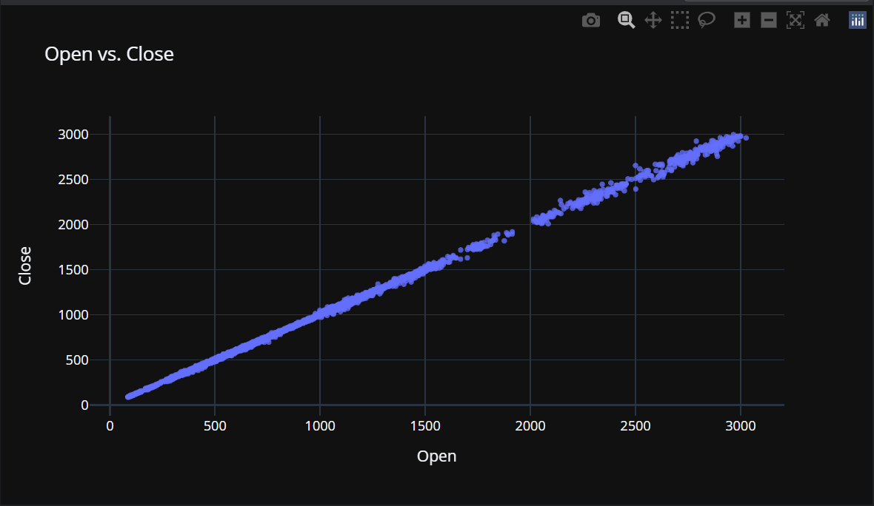
Correlation between open and close
As we can see from the graph There is strong correlation between open close
These features can provide valuable information to the model about the relationship between the opening and closing prices of the stock.
The GRU model can learn to exploit the correlation between these prices over time to make more accurate predictions.
The correlation between open and close prices can serve as a form of regularization for the model. By incorporating this relationship into the training process, the model can learn to generalize better to unseen data and mitigate overfitting.

Slide 16
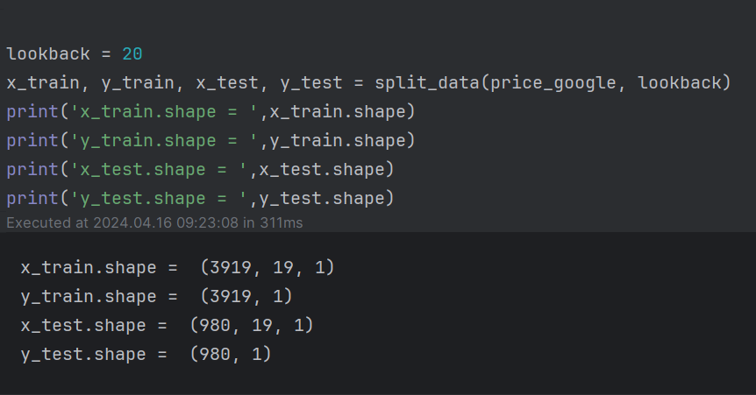
Splitting the data for training and testing
Google collab link:https://colab.research.google.com/drive/1C46b1u9Q-8nBz9TsyaA3qrn-ErgaxNfY#scrollTo=Fn03vQNZ6Alt

Slide 17
Choosing the right structure for the model
input_dim = 1 (input layer)
hidden_dim = 32 (hidden layers)
num_layers = 2
output_dim = 1 (output layers)
num_epochs = 105 (number of iterations)
Lr = 0.01 ( learning rate)

Slide 18
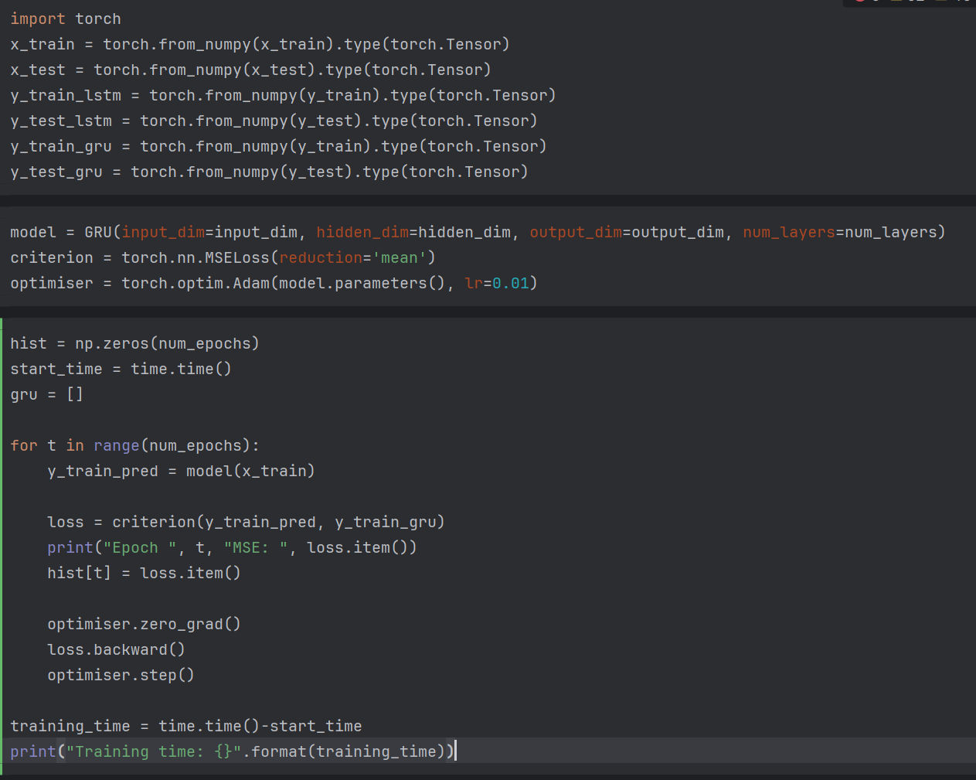
Training the data

Slide 19
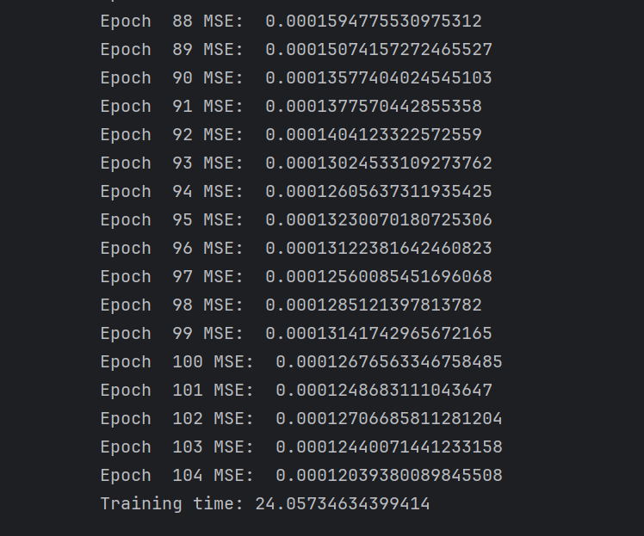
Epoch vs MSE
We can observe the that there is a significant decrease in the mean square errors for each iteration

Slide 20
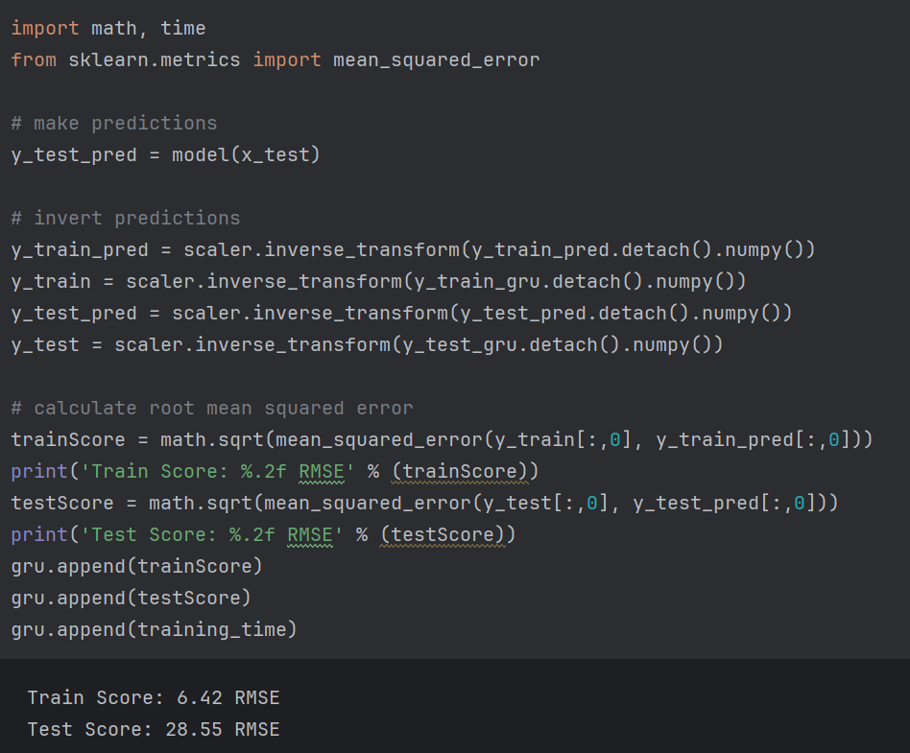
Train Score vs Test Score
Key Takeaways:
As we can see that
the difference between the training score and test score is comparably low
So that we can rely on the model ensuring that the model isn't overfitting or underfitting

Slide 21
Lets see whats happens if we play around with number of layers
input_dim = 1 (input layer)
hidden_dim = 24 (hidden layers)
num_layers = 4
output_dim = 1 (output layers)
num_epochs = 105 (number of iterations)
Lr = 0.01 ( learning rate)
note:We didnt try to lower the learning as it would result in exponential growth in training time

Slide 22
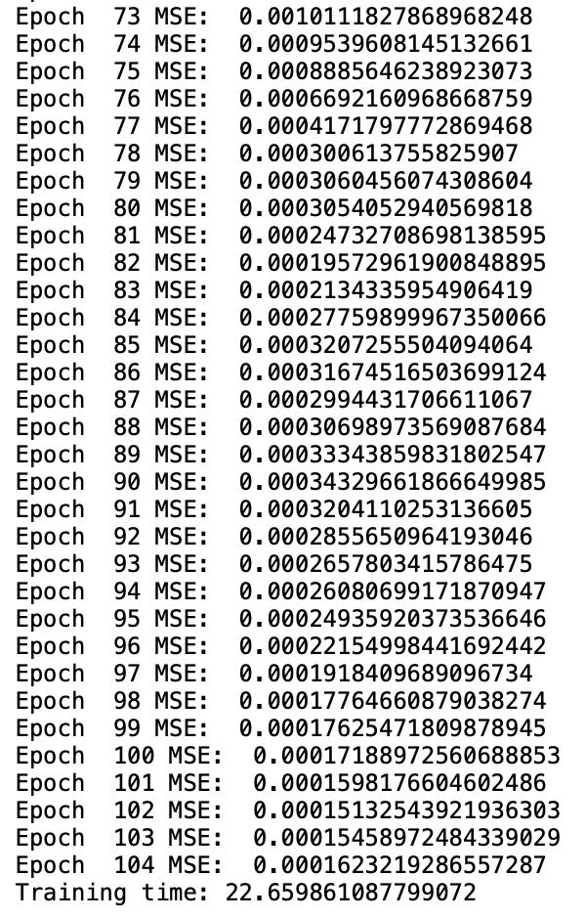

Epoch vs MSE
Key Takeaways:
We can observe the that there is a significant decrease in the mean square errors for each iteration which looks good
But the problem is with training score and test score in which the difference between them is much larger compared to what we had seen earlier
This is the case for overfitting in which model gives accurate results for training data and but cannot generalise
In conclusion, while the reduction in MSE signifies positive training progress, the substantial gap between training and test scores underscores the necessity for addressing overfitting

Slide 23
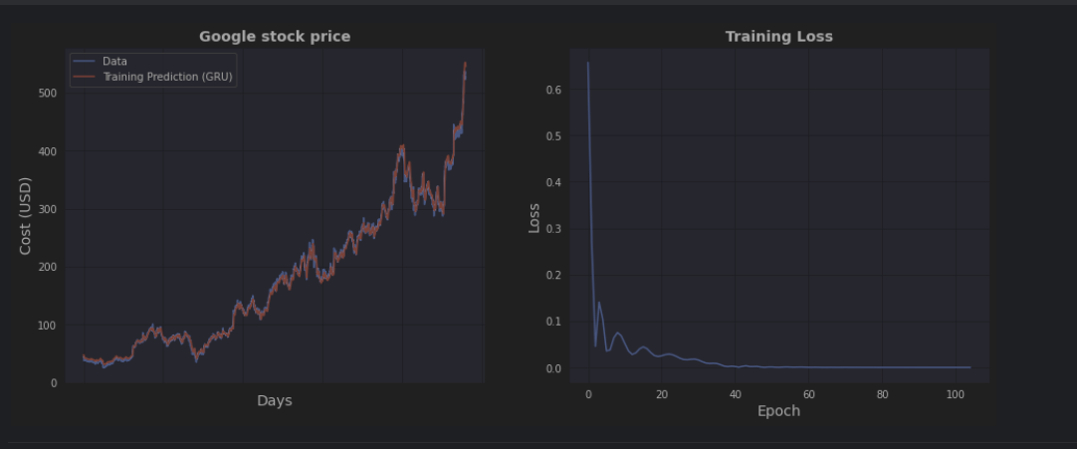

Slide 24
Video Link:
https://youtu.be/h3r39iX2IGs

Slide 25
THANK YOU

